Slide 1

Building façade object detection using YoLoV8m
Akshay Saxena
ME GGE
Notes:
Hello my name is Akshay Saxena. I am a post graduate student in geomatics and geodesy department at the University of New Brunswick. Today, I will present you my work on detecting the façade objects in buildings using YoLoV8m so let’s begin.

Slide 2


Agenda
Introduction
Methodology
Results
Tests
Future work
References
Notes:
Here is the agenda of the topics I will be covering in my presentation.
Into…..
Methodo…..
…..

Slide 3
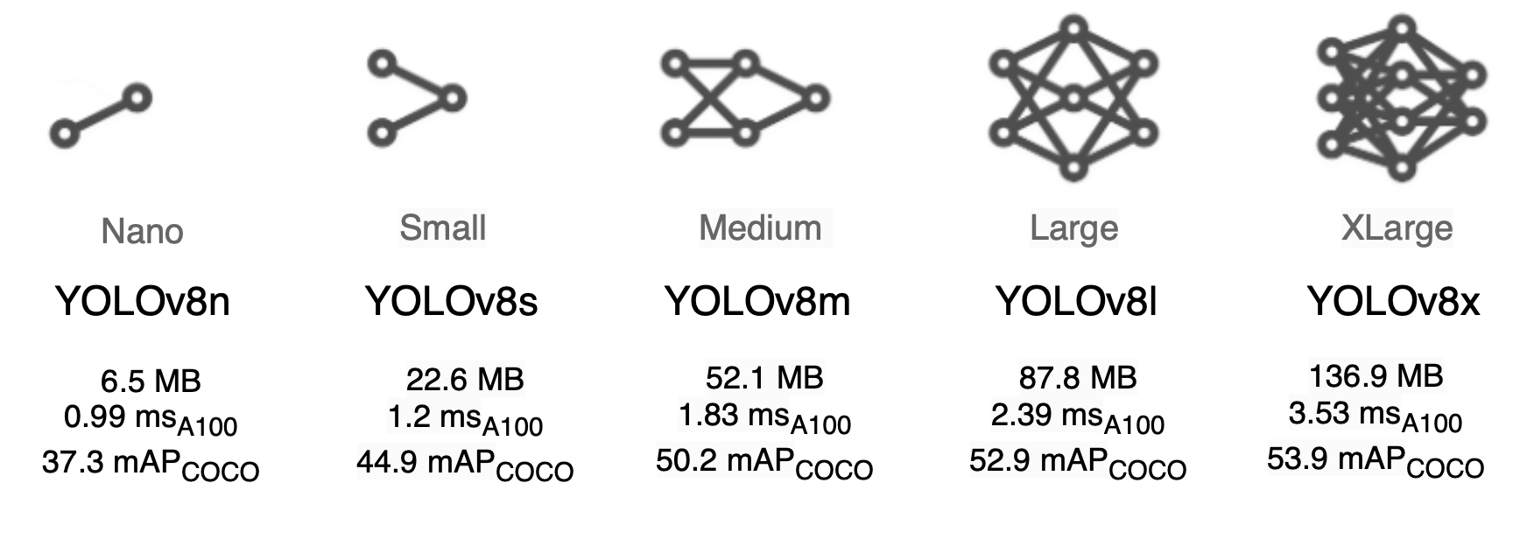
Introduction
Detecting building façade elements is a crucial problem in computer vision for image interpretation. Façade segmentation was first studied in the 1970s using hand-crafted expertise. Later, detection and segmentation studies emerged based on shapes of objects and parametric rules. With the developing technology, deep learning approaches in object detection studies have intensified. It is obvious that the desired analyses can be performed faster with deep learning approaches.
Notes:
Let’s talk about the history of detecting the façade object detection. The hand-crafted expertise was used in 1970s to study the façade segmentation. With advancement in technology, the present-day approaches utilize the deep learning methods for detection. The deep learning algorithms are efficient as well as fast to bulk detect the façade objects within various scene settings with sufficient accuracy. I have used YoLoV8m to get an accuracy of 0.6 at mAP 0.5. Here, the threshold used is 0.5 which defines the ratio of intersection over union values between training and validation bounding boxes of the classes.

Slide 4
Methodology
Stairs
Doors
Windows
I have tried to implement YoLoV8m deep learning model developed and pre-trained by Ultralytics.
The custom datasets used for training and validation consists of 3 classes naming windows, doors, and stairs.
Dataset sources: -
Labelled images of Doors from https://github.com/sayedmohamedscu/YOLOv8-Door-detectionfor-visually-impaired-people ,
dataset of doors, stairs and windows from https://www.kaggle.com/code/amartinez111/window-or-door and
https://drive.google.com/file/d/1-0dWfmeUXN7V1tvZQubcRW6frCEu8fjq/view
1366 images as validation set and 3504 images as training set.
Total 4870
Notes:
The YoLoV8m stands for You Only Look Once Version 8 Medium size architecture deep learning model. It is developed by Ultranalytics, and python library is provided by them which is utilized by many developers to carry out various detection projects. The ratio of intersection and union values between training and validation bounding boxes of the classes defines how efficiently the model can predict the trained classes by calculating the average of overlaps between the actual and predicted bounding boxes.
I have used 1366 images as validation set and 3504 images as training set.
Total 4870 images for my work.

Slide 5
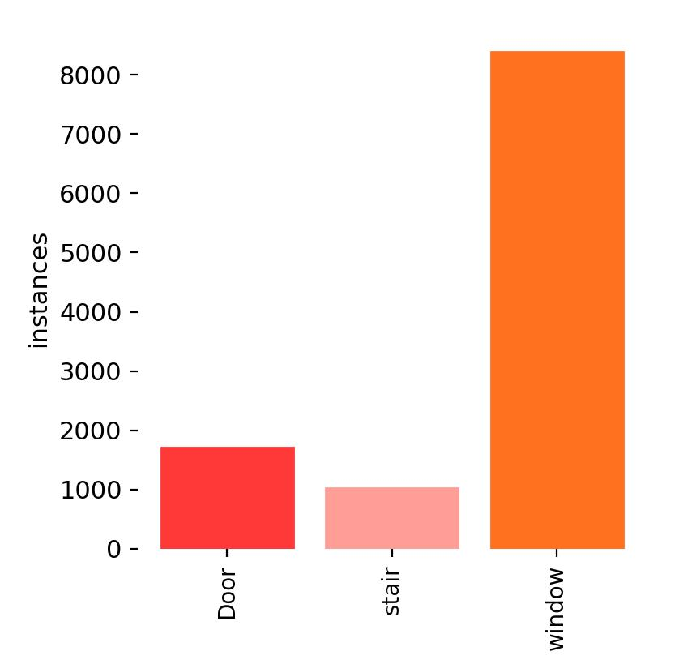
Results
Notes:
Now, let’s have a look at the results of my work.
The number of labels per class is as follows: The number of labels for doors is around 2000, The number of labels for stairs is around 1000 and The number of labels for windows is around 8000.

Slide 6
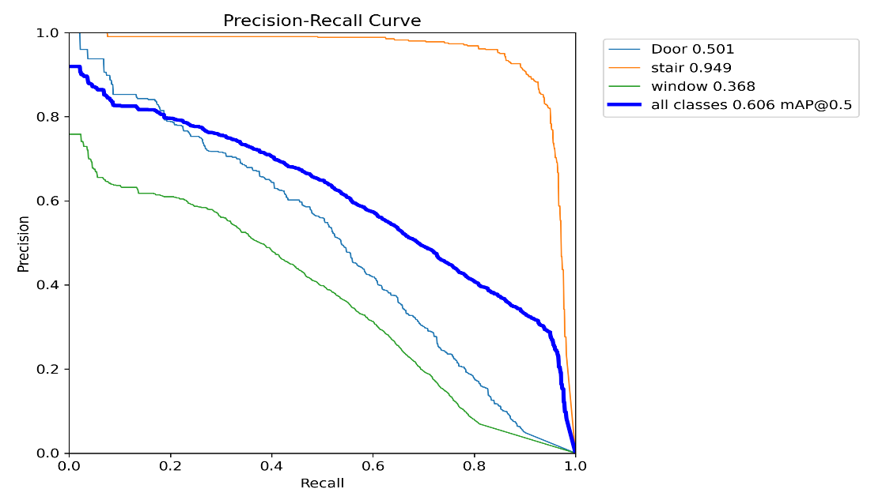
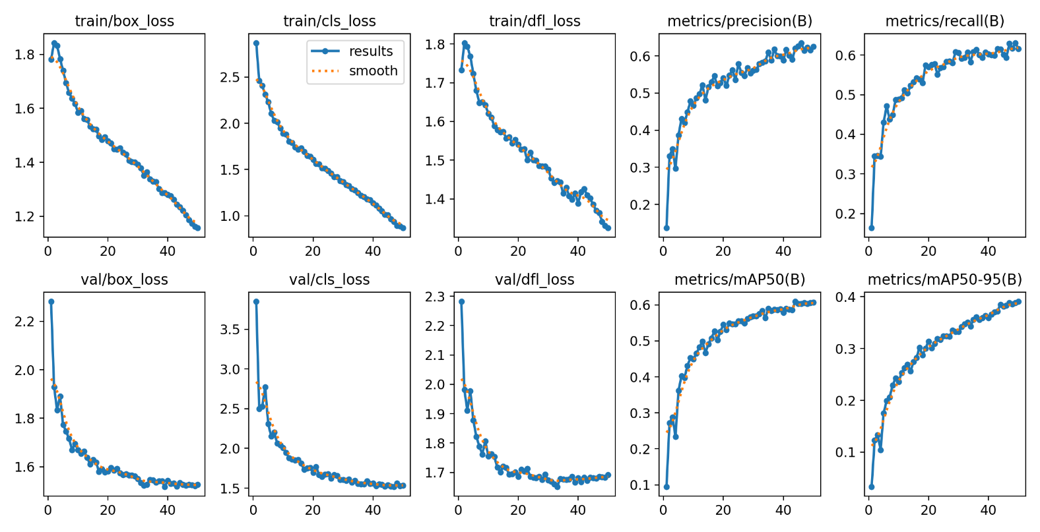
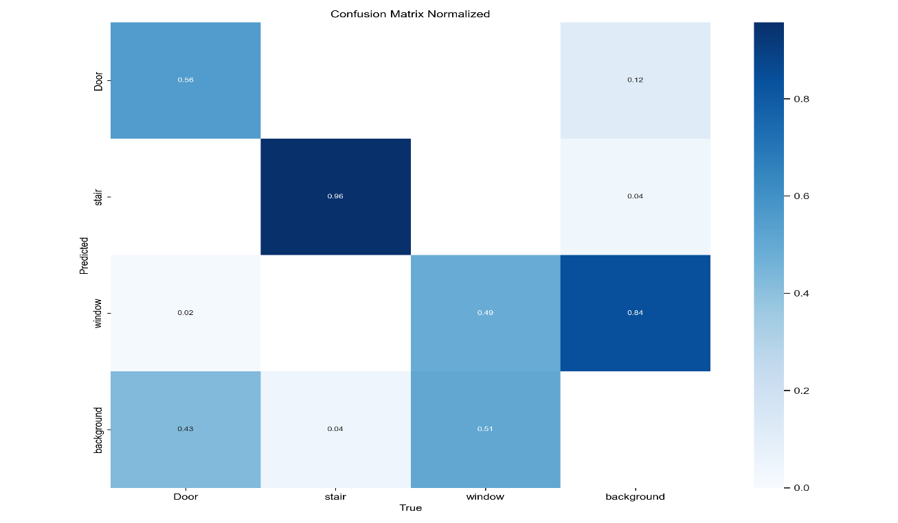
Image size (1280X1280), batch = 8, epochs = 50
Notes:
I have taken image resolution for training to be 1280 into 1280. Batch size to be 8 and number of epochs to be 50.
-> The image size is taken to be large as the bounding boxes of the labelled images are squeezed if the resolution of the training images is reduced which results in poor detection of the windows.
The batch size can be increased for faster training of the deep learning model however; it requires large amount of memory. Here, I have used 12 gigabytes of Nvidia RTX 4080 GPU (Graphics Processing Unit). On further increment of batch size, the iterations stops as the processing requires even more memory to process the training with the parameters.
One epoch is complete when the model has processed all the batches and updated its parameter based on calculated loss. The processing of a batch of data through the model, calculating the loss, and updating the model’s parameters is called an iteration. In one epoch one or more iterations can be possible depending on the number of batches in the dataset. In deep learning, the training dataset is generally divided into smaller groups called batches, and during each epoch, the model analyzes each batch in sequence, one at a time. The number of batches in an epoch is determined by the batch size, which is a hyperparameter that can be tuned to optimize the performance of the model. After each epoch, the model performance can be evaluated on the validation dataset. This helps to monitor the progress of the model.
The number of epochs is a hyperparameter that is set by the user. In general, increasing the number of epochs improves the performance of the model by allowing it to learn more complex patterns in the data. If there are too many epochs, the model may overfit, So, it is important to monitor the model’s performance on a validation set during training and stop training when the validation performance starts to decay.
Similar to batch size, the number of epochs are taken into consideration based on the memory available for training.

Slide 7
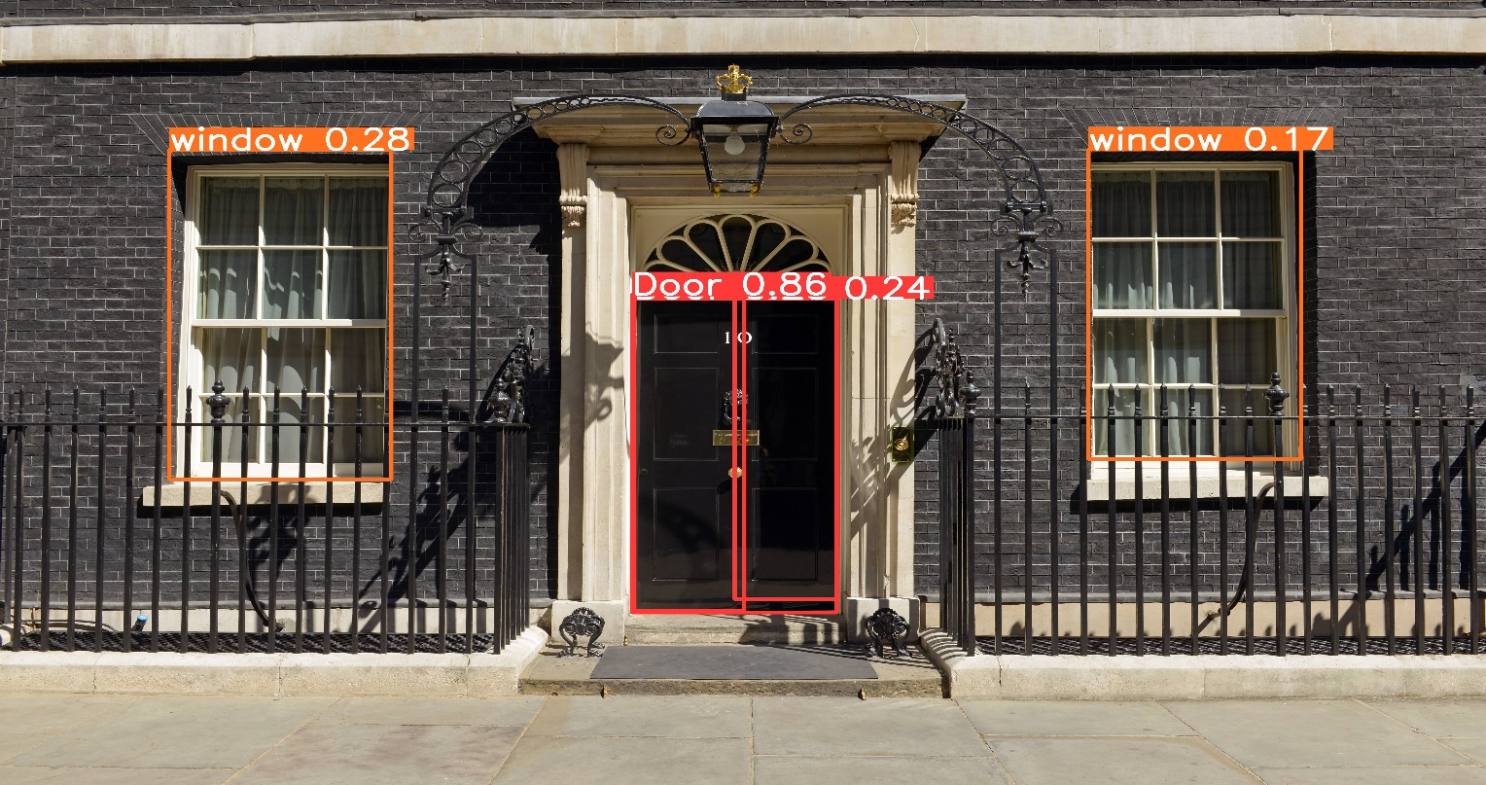
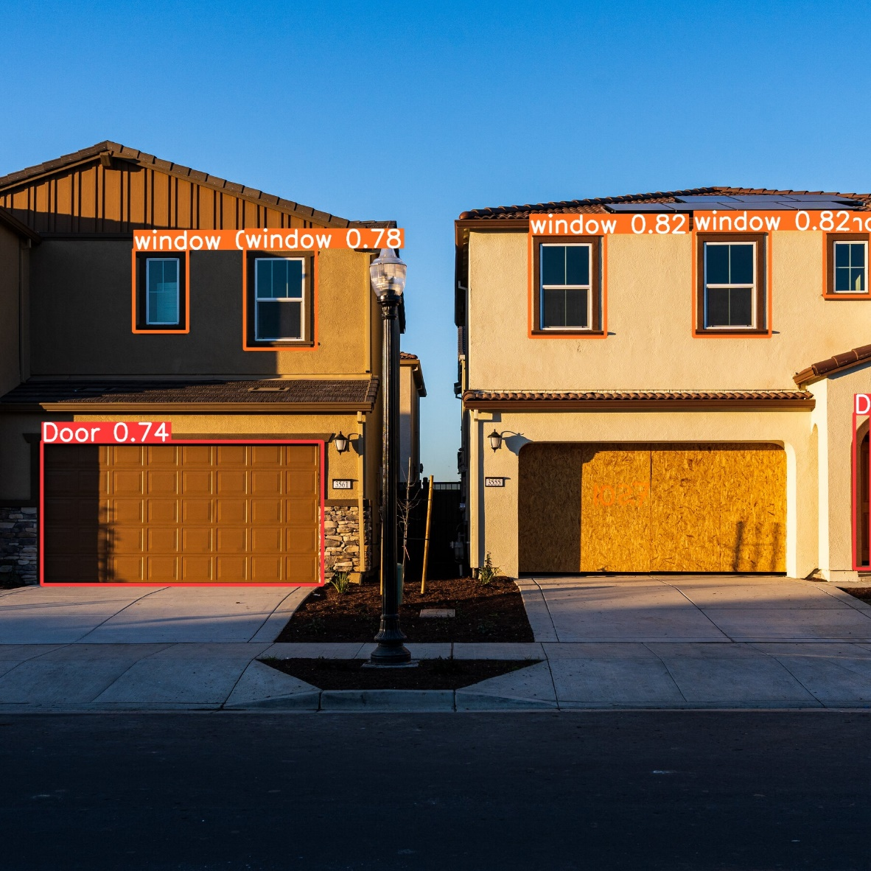
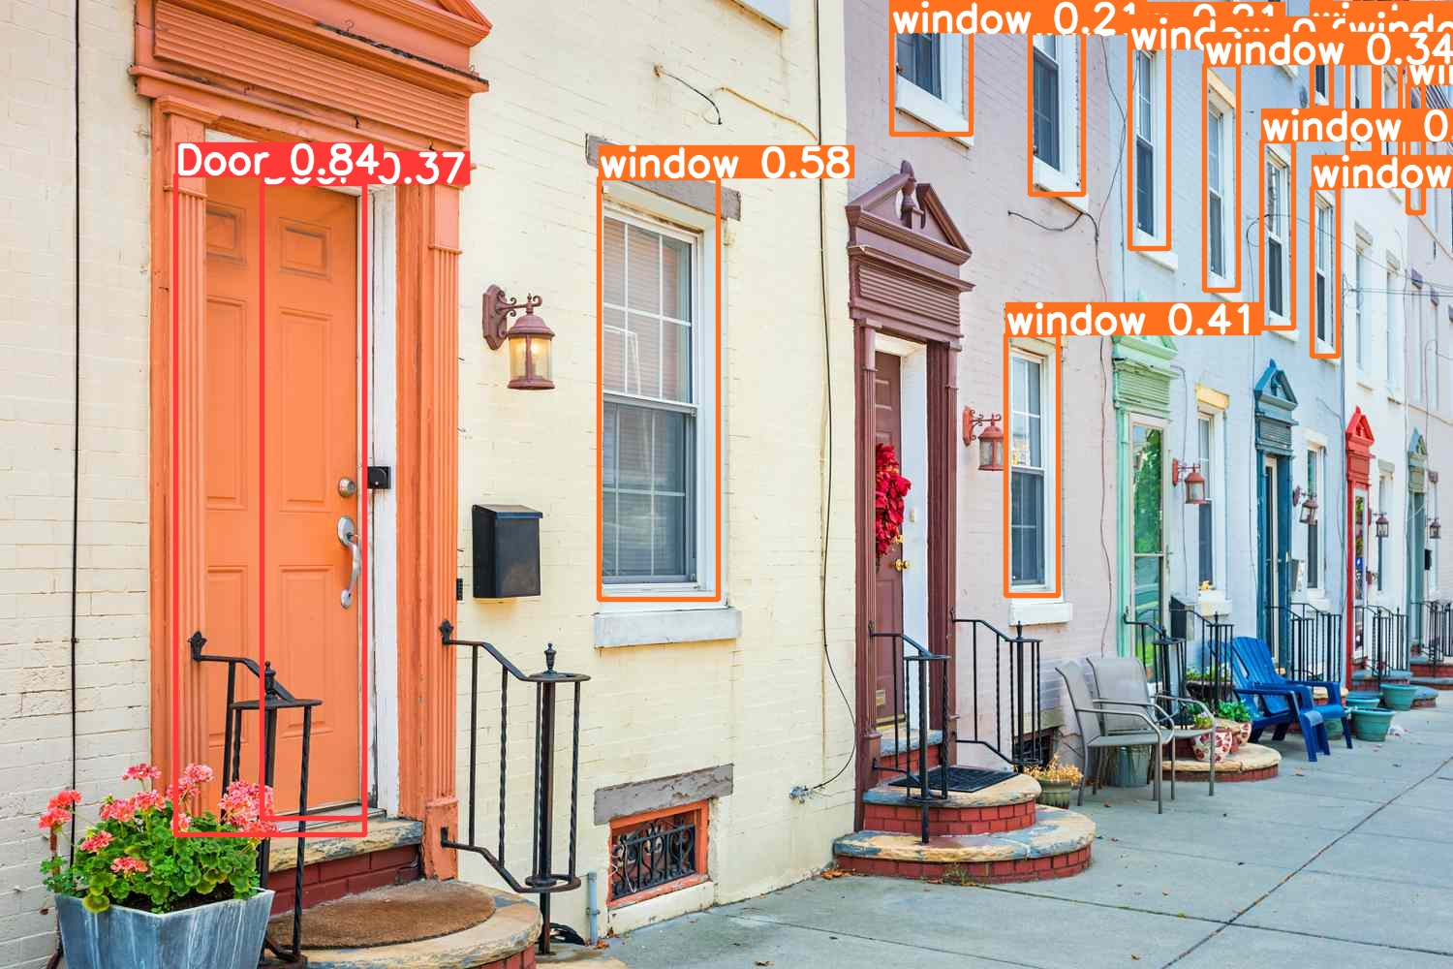
Tests

Slide 8
Future work
The YoLoV8m model will be able to classify objects such as doors, windows, stairs, etc. (as per training data contents) from the building images. This extracted information can be stored to enrich the BIM (Building Information Modelling) information on certain projects.
My future work will involve using the trained weights from YoloV8m to be transferred to Vit (Vision Transformer) using fully connected layer at the end of Vit classifier.

Slide 9
References
Zhang, G., Pan, Y. & Zhang, L. (2022). Deep learning for detecting building façade elements from images considering prior knowledge. Automation in Construction, 133, 104016-. https://dx.doi.org/10.1016/j.autcon.2021.104016
Sacks et al., 2018 R. Sacks, C.M. Eastman, G. Lee, P. Teicholz BIM Handbook: A Guide to Building Information Modeling for Owners, Designers, Engineers, Contractors and Facility Managers John Wiley and Sons, Hoboken, NJ (2018)
Sezen, G., Cakir, M., Atik, M. E., and Duran, Z.: DEEP LEARNING-BASED DOOR AND WINDOW DETECTION FROM BUILDING FAÇADE, Int. Arch. Photogramm. Remote Sens. Spatial Inf. Sci., XLIII-B4-2022, 315–320, https://doi.org/10.5194/isprs-archives-XLIII-B4-2022-315-2022, 2022.
Amang, S. ., Sen, B. ., Pradhan, A. ., Sharma, K. ., & Singh, V. K. . (2023). Enhancing COVID-19 Safety: Exploring YOLOv8 Object Detection for Accurate Face Mask Classification. International Journal of Intelligent Systems and Applications in Engineering, 11(2), 892–897. Retrieved from https://ijisae.org/index.php/IJISAE/article/view/2966
Notes:
Here are the references used to carry out my work.

Slide 10
Thank You!

